Slide 1

Watson Assistant Labs Gary Wilson CTO & Technical Leader, UKI Commercial Business

Slide 2
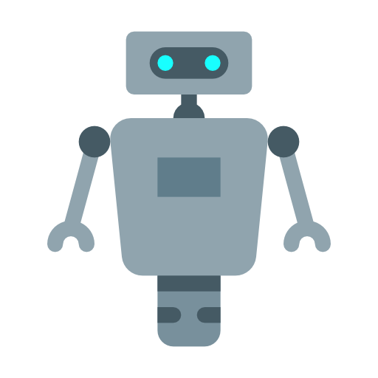
Build a Cognitive Chatbot
“I’d like advice on a new phone”
“How many times can I install an application I've purchased on the Market?”
“I’m interested in a new contract”
“My LG D800 is grinding to a halt, what can I do?”
”Here’s my review of the Galaxy S8”
“Can you give me some info on the iPhone XR?”
Notes:
- These labs will have you working on building a COGNITIVE CHATBOT (Phone Advisor)
- By the end of the lab your chatbot should:
- work using a number of different UIs
- provide text, image and option response to the user
- use Watson Assistant to answer BASIC questions to
help find a NEW mobile phone and CONTRACT for a user
- use Watson NLU to grade the SENTIMENT of a review you
can submit about a phone
- use Watson Discovery to answer more SPECIFIC
'support' type questions
- use the Wikipedia API to get information on a phone

Slide 3

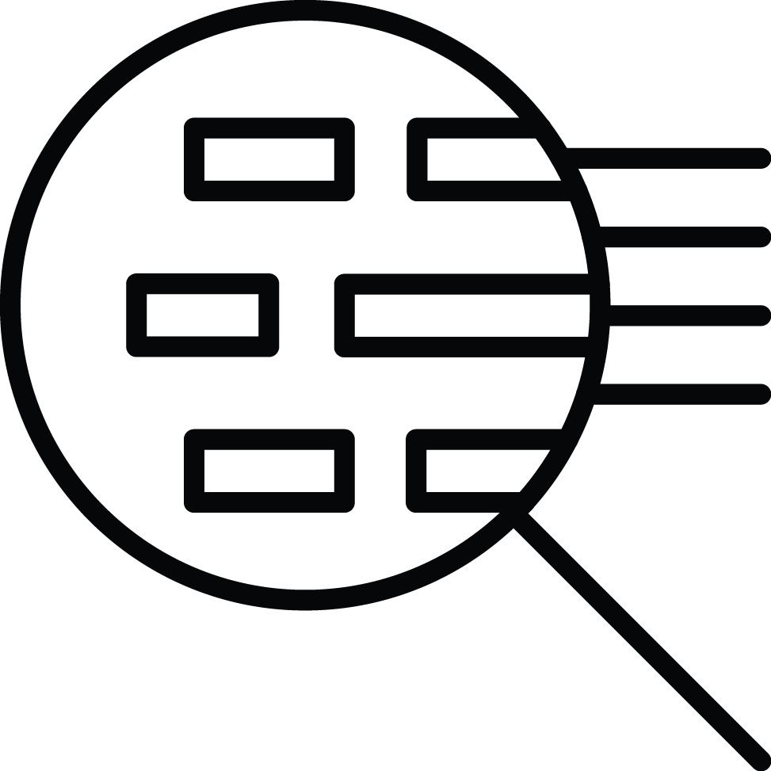
Chatbot: Question Distribution
Watson
Assistant
Here Watson uses reasoning strategies that focus on the language and context of the question.
How do I get a Visa?
I need to visit Zimbabwe as a British citizen with a criminal record—can I do that?
Frequency of Questions
Watson Discovery
Here Watson uses reasoning strategies that focus on identifying the most appropriate answer.
Short Tail
Long Tail
100s
100,000+
Unique Intents
Notes:
- We will use Watson Assistant and Watson Discovery to
answer both short-tail and long-tail questions
- Short-tail questions are typically more PREDICTABLE and
FREQUENT, and will be dealt with by Assistant
- Long-tail questions are typically more SPECIFC, and
retrieved from a KNOWLEDGE BASE, which we will do here
with Discovery

Slide 4
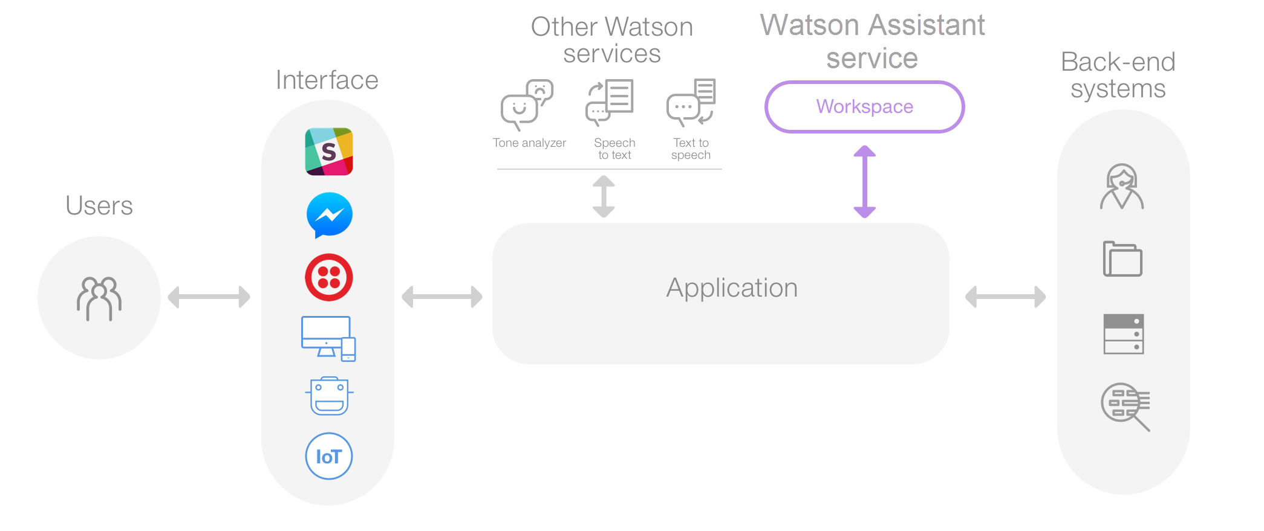
Cognitive Chatbot – Architecture
Wikipedia
Watson Discovery
Watson NLU
Notes:
- This is a common Watson Assistant architecture
- Application can use multiple UIs
- FLOW of the conversation is controlled by Watson Assistant
- INTERFACES to back-end systems when required
- We'll utilise this architecture, using:
- A web application & Slack as our UIs, and
- Discovery, NLU & IBM CFs to enhance our bot

Slide 5
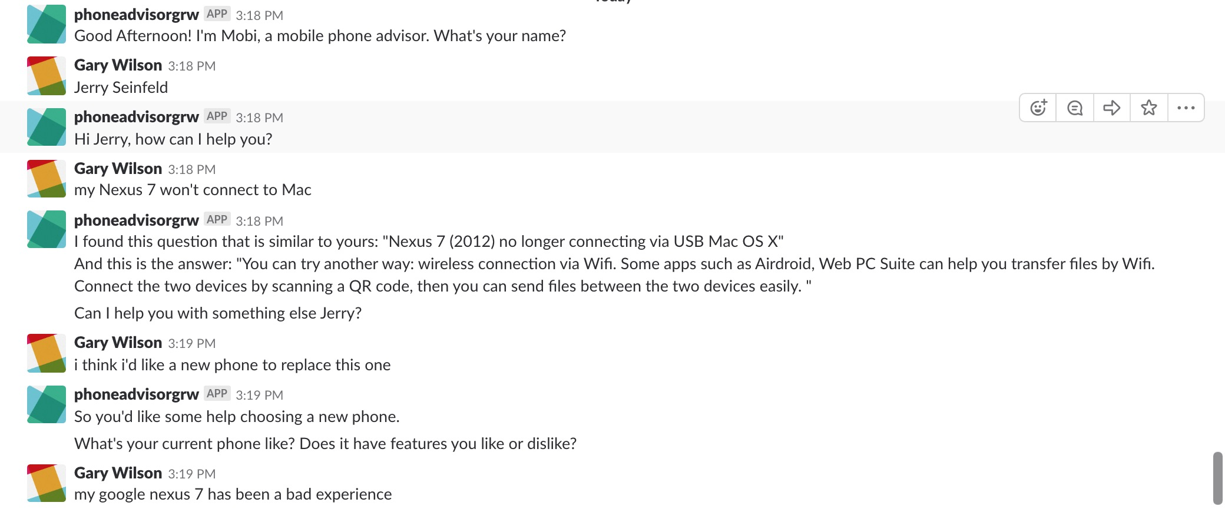
Your Chatbot…

Slide 6
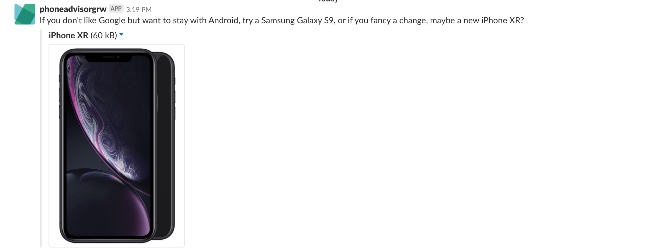
Your Chatbot…

Slide 7
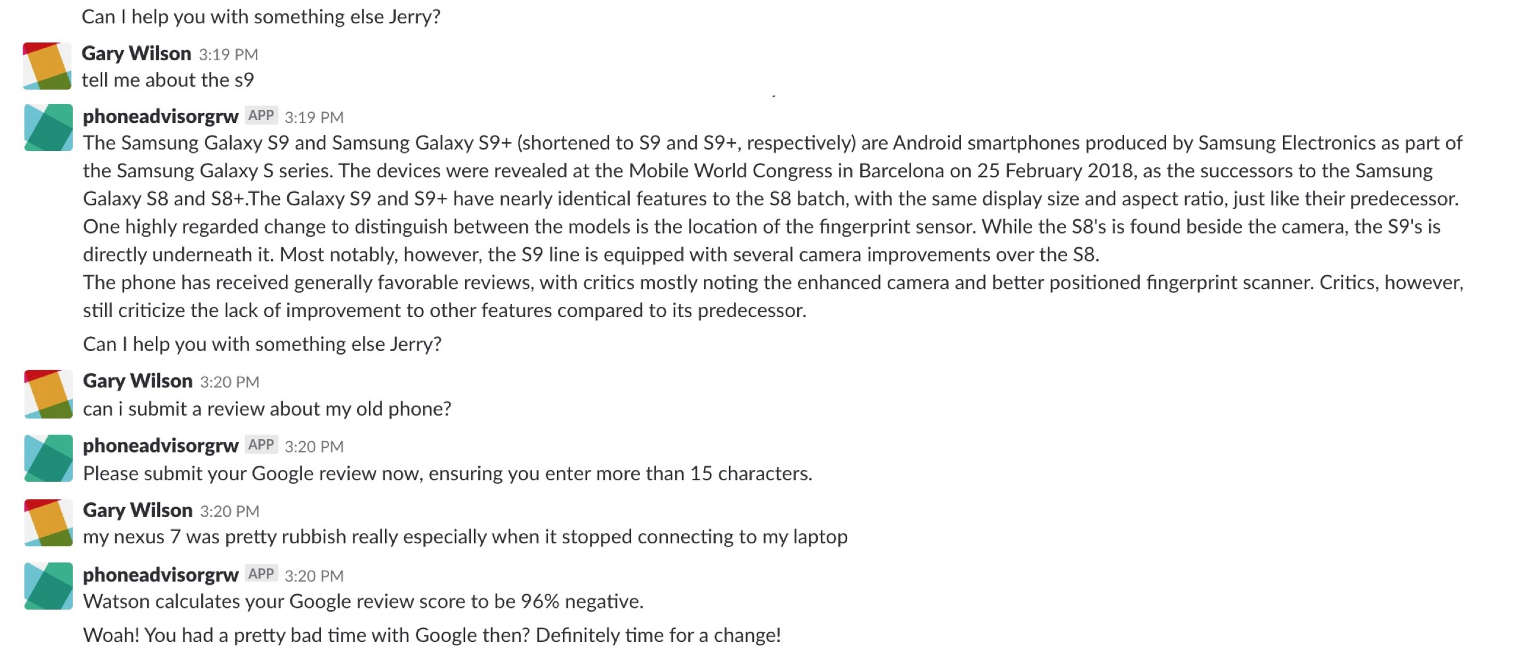
Your Chatbot…

Slide 8
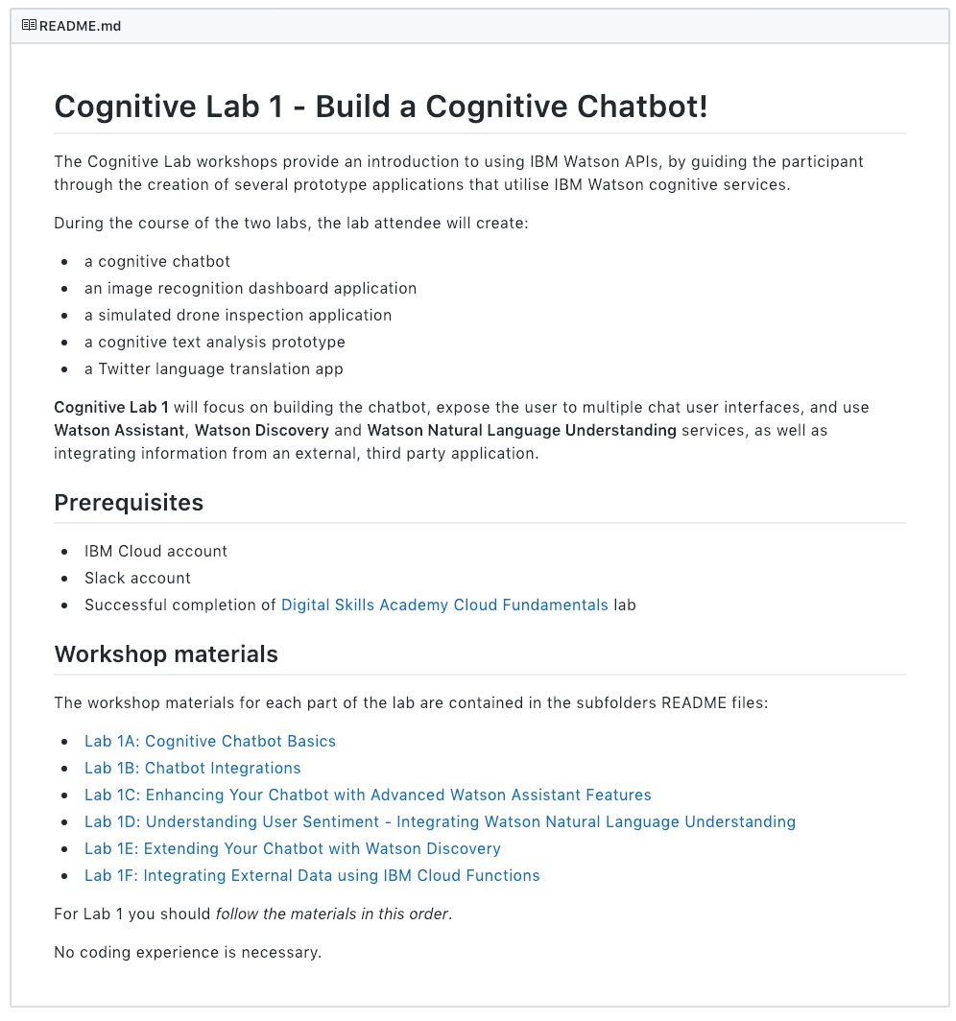
Lab Format
Step-by-step instructions
GitHub README.md for each lab
Work at your own pace
https://github.com/garyrwilson/Watson-Assistant-Labs

Slide 9

Watson Assistant Labs Gary Wilson CTO & Technical Leader, UKI Commercial Business

